Slide 1
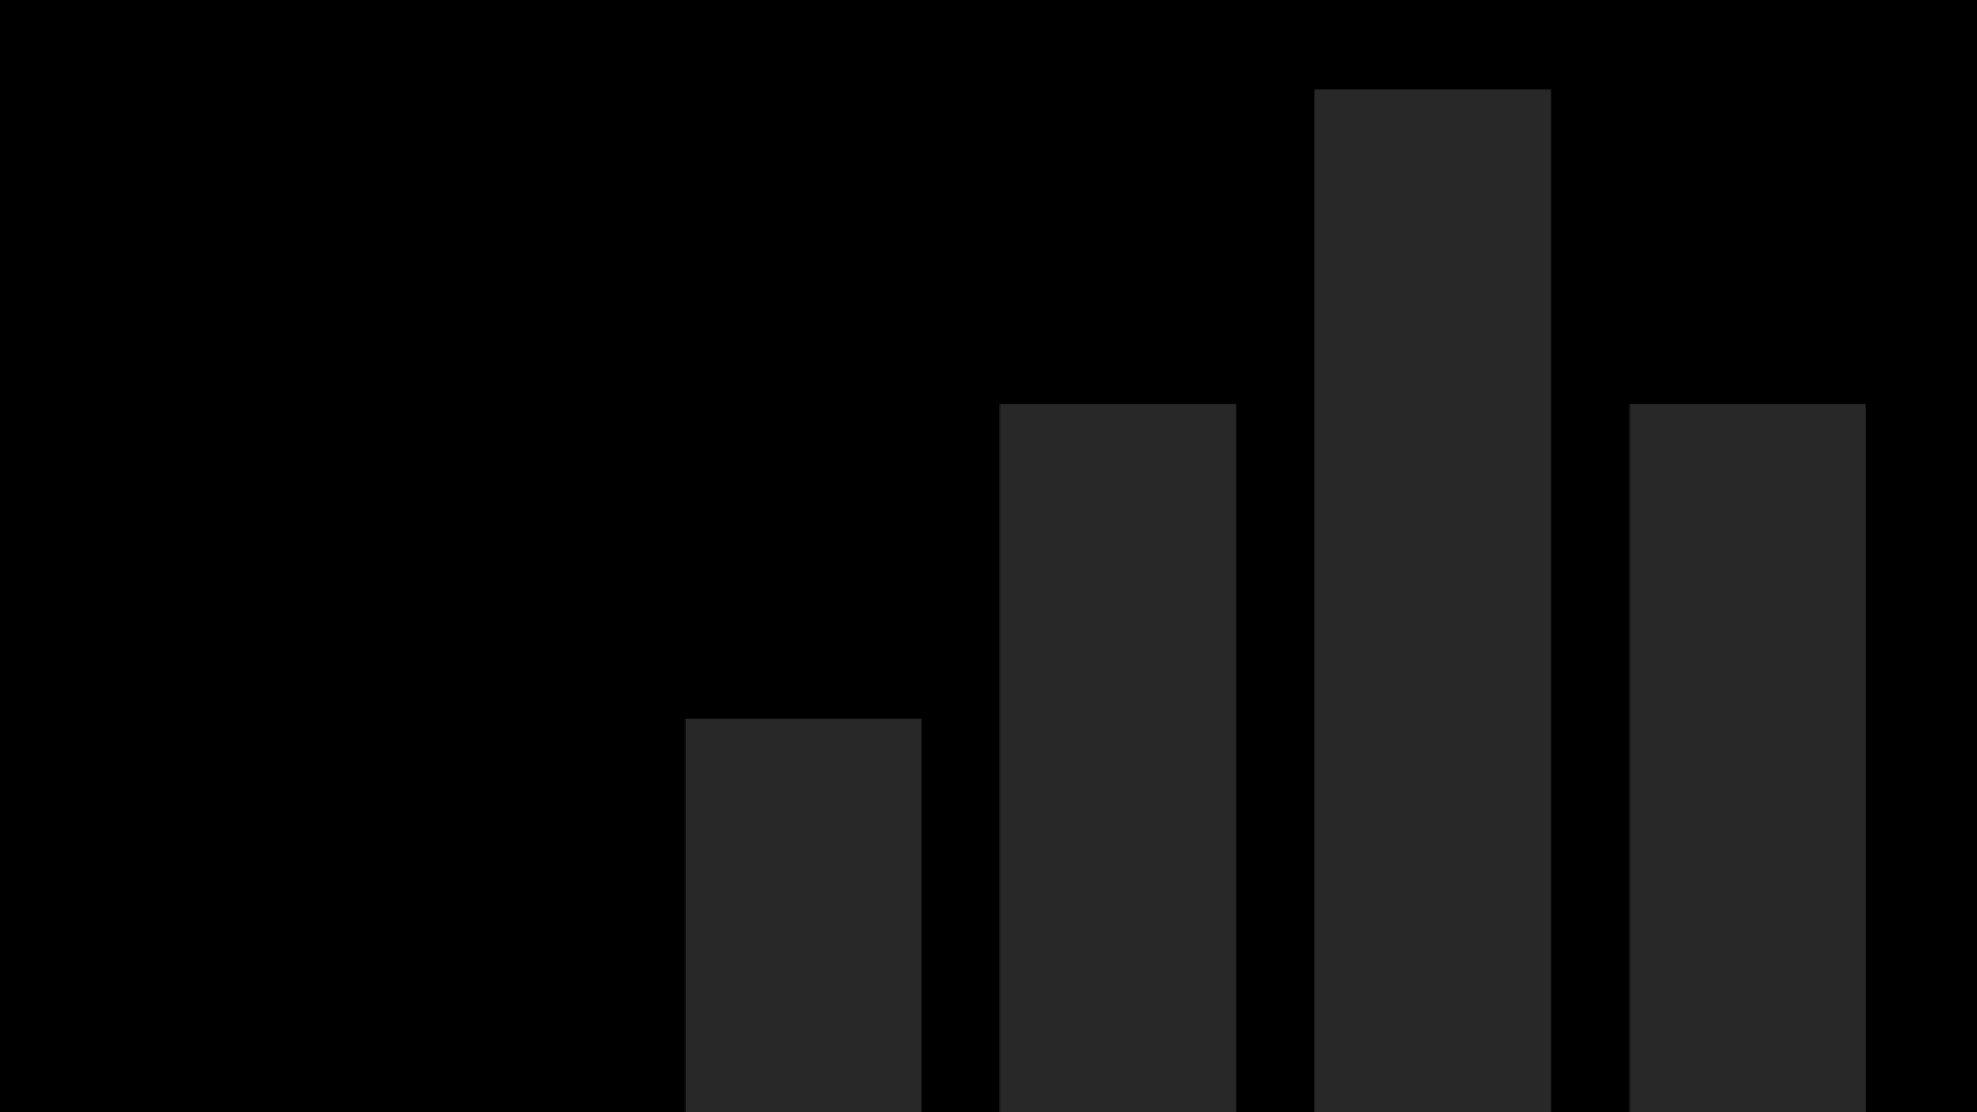
Capstone Project – Sales Analytics

Slide 2
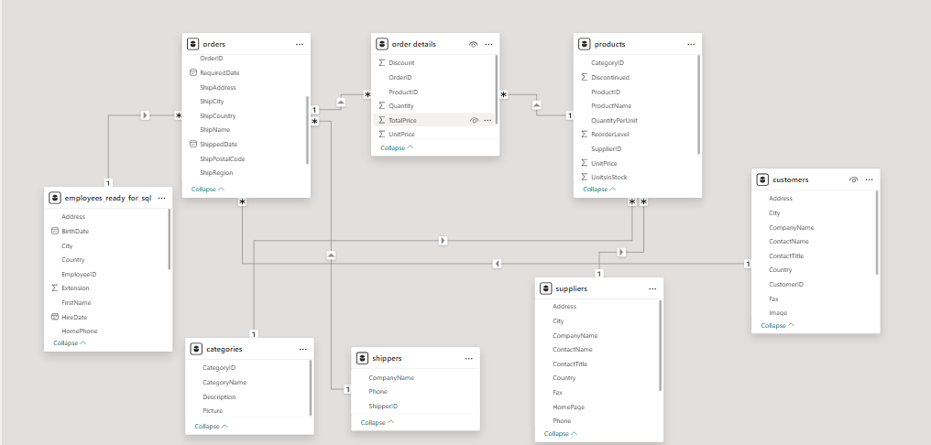
ER Diagram
5

Slide 3

Power BI Problem
Statements

Slide 4
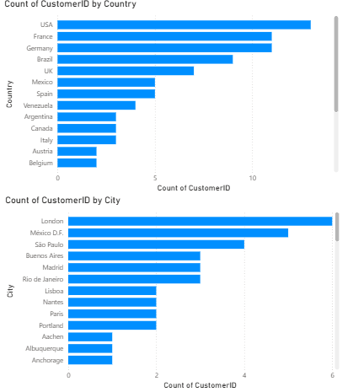
How does customer distribution vary across different countries or cities?
Gleaning from the distribution report, it becomes apparent that countries such as USA, France, and Germany boast the highest number of customers, indicating strong market presence in these regions. Conversely, nations like Austria, Italy, and Belgium exhibit a comparatively lower customer count. At the city level, London, Mexico D.F., and São Paulo emerge as the top cities with the largest customer base, whereas cities like Aachen, Albuquerque, and Anchorage show relatively minimal customer representation.
9

Slide 5
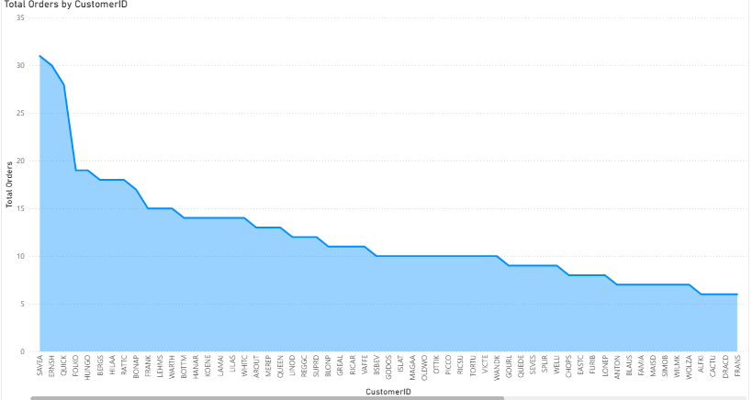
What is the trend in customer orders over time?
Gleaning from the Customer Report, it becomes apparent that customers such as SAVEA, ERNSH, and QUICK have placed the highest number of orders, indicating strong engagement or recurring purchases. Conversely, customers like DUMON, CACTU, and FRANK exhibit comparatively fewer orders, suggesting lower activity or infrequent transactions. This highlights a clear skew in customer order distribution, with a small group of highly active buyers driving a significant portion of total sales.
10

Slide 6
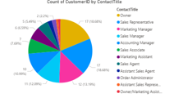
What is the distribution of customers by Contact Title or Region?
Gleaning from the Contact Title Report, it becomes evident that Owners and Sales Representatives constitute the largest proportion of customers, indicating a strong presence of business decision-makers and front-line sales personnel. Conversely, roles such as Assistant Sales Agent, Order Administrator, and Marketing Assistant represent a smaller share, suggesting fewer customers from support and coordination positions. This distribution highlights that most customer interactions likely occur at managerial or ownership levels.
11

Slide 7
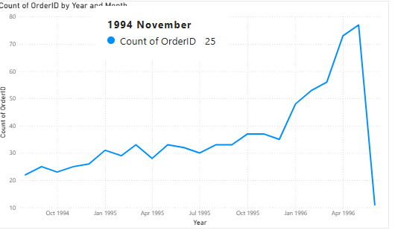
How does order volume change over time?
Gleaning from the Order Trend Report, it becomes evident that the order volume shows a steady upward trajectory from late 1994 through early 1996, indicating consistent business growth. The sharp rise between late 1995 and mid-1996 suggests a surge in customer demand or expanded operations. However, a sudden decline after mid-1996 points to a possible seasonal effect, market change, or temporary dip in sales activity.
11

Slide 8
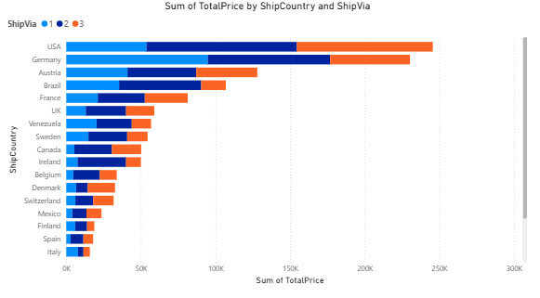
What is the distribution of order values?
The visualization shows that the USA and Germany dominate total order values, contributing the highest sales revenue across all shipping methods. Austria, Brazil, and France follow with moderate totals, while Italy and Spain record the lowest. Additionally, ShipVia 3 manages a large share of shipments in high-value markets, underscoring its operational importance.
11

Slide 9
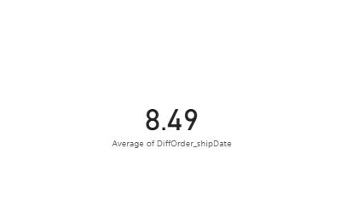
What is the average order shipping duration?
The data indicates that the average order shipping duration is approximately 8.49 days. This suggests that, on average, customers receive their orders within nine days of placement, reflecting a reasonably efficient shipping process. Monitoring this metric over time can help identify trends or potential delays in the supply chain.
11

Slide 10
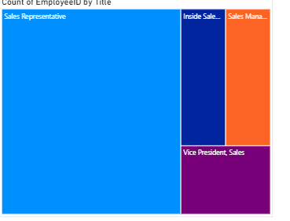
What is the count of employees by job title or region?
The visualization shows that Sales Representatives form the largest group of employees, indicating a strong emphasis on customer engagement and revenue generation. Inside Sales Coordinators and Sales Managers follow at a smaller scale, while the Vice President of Sales role is represented by only a few individuals, reflecting the typical hierarchical distribution within a sales organization.
13

Slide 11
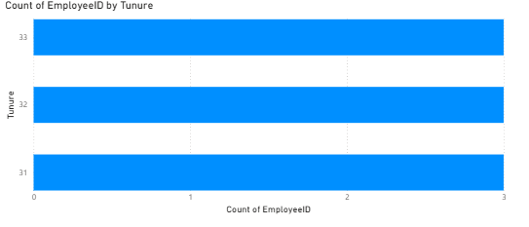
What is the distribution of employee tenure?
The visualization shows that employees are evenly distributed across tenure levels, with each tenure group (31, 32, and 33 years) having a similar count of employees. This indicates a balanced workforce in terms of experience, suggesting consistent employee retention and low turnover across long-serving staff.
14

Slide 12
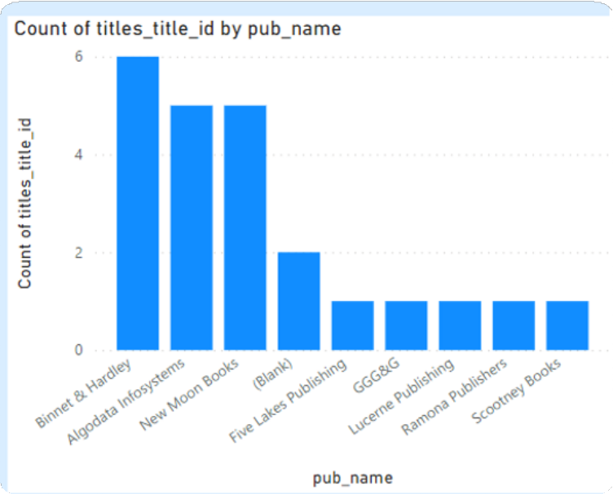
What is the reporting structure among employees?
The visualization shows that the reporting structure is moderately hierarchical, with most employees reporting to a few key supervisors. Specifically, employees under manager ID 2 include Sales Representatives, an Inside Sales Coordinator, and a Sales Manager, reflecting a clear chain of command within the sales department. This structure supports effective oversight and streamlined communication within teams.
15

Slide 13
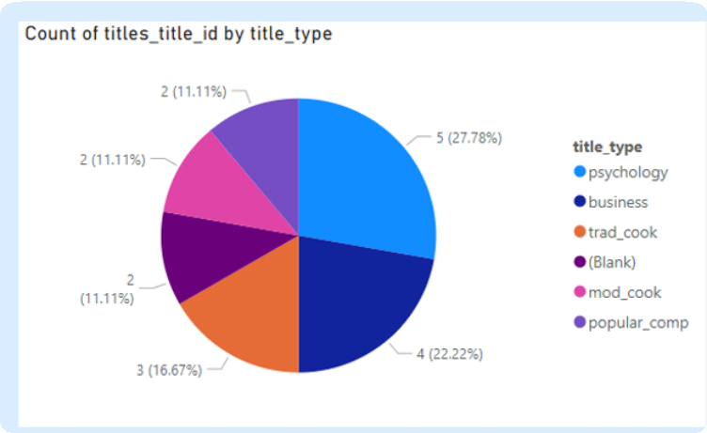
How many universities are there in each country?
Gleaning from the Country Report, it becomes apparent that nations such as the USA, China, and Japan boast the highest number of universities. Conversely, countries like Uganda, the UAE, and Uruguay exhibit a comparatively lower count of universities.
17

Slide 14
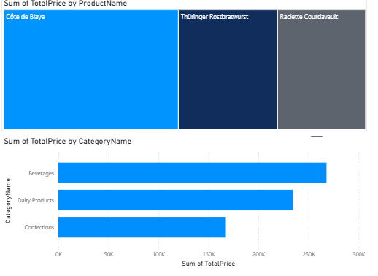
Which products have the highest sales volume?
The data indicates that “Côte de Blaye” generates the highest sales volume, followed by “Thüringer Rostbratwurst” and “Raclette Courdavault.” At the category level, Beverages lead in total sales, followed closely by Dairy Products and Confections. This suggests that beverage items are the primary revenue drivers, while dairy and confectionery products also contribute significantly to overall sales performance.
18

Slide 15
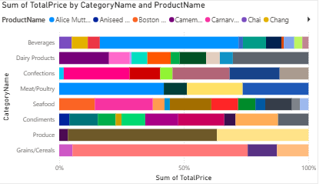
How does the sales volume vary across different product categories?
The visualization shows that sales volumes vary significantly across product categories. Categories such as Beverages, Dairy Products, and Confections contribute the largest portions of total sales, while Condiments, Produce, and Grains/Cereals show relatively smaller shares. Within each category, a few key products dominate sales, indicating a concentration of revenue among top-performing items rather than an even distribution across all products.
19

Slide 16
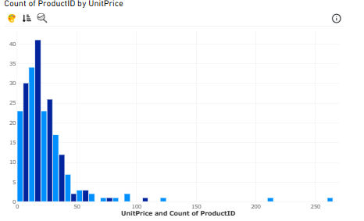
Can we visualize the pricing distribution of products?
The visualization shows that product prices are heavily concentrated in the lower range. Most products are priced below 50 units, indicating a focus on affordable and mid-range offerings. A smaller number of products are priced between 50 and 100 units, while only a few fall above 150 units, representing premium or niche items. This distribution suggests that the product portfolio primarily targets cost-conscious customers, with limited emphasis on high-end pricing segments.
21

Slide 17
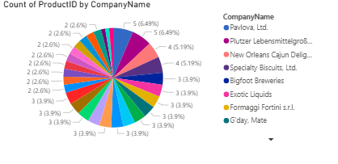
How many products are supplied by each supplier?
The visualization shows the count of products supplied by each company. Most suppliers contribute a small and fairly even share, typically ranging between 2 to 5 products each. A few suppliers, such as Pavlova Ltd. and Plutzer Lebensmittelsgroßmärkte AG, supply a slightly higher number of products (around 5 products each), while many others contribute 2–3 products. This indicates that the product supply is distributed across multiple suppliers, with no single supplier dominating the catalog.
22

Slide 18
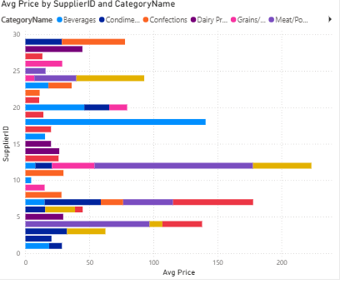
How does product pricing vary across different suppliers?
The visualization shows that average product prices vary considerably across suppliers. Some suppliers, such as those represented by Supplier IDs 10, 15, and 25, offer products with higher average prices, especially in categories like Meat/Poultry and Dairy Products. Others, such as Supplier IDs 5 and 8, provide lower-priced items across multiple categories like Beverages and Confections.
This indicates that pricing differences are influenced by both the supplier and the product category — suppliers specializing in premium or perishable goods tend to have higher prices, while those focusing on general consumables maintain more moderate pricing.
23

Slide 19
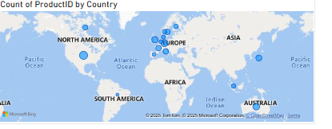
What is the geographical distribution of suppliers?
The visualization shows that the majority of suppliers are concentrated in Europe, with a notable presence in countries such as Germany, France, and the United Kingdom. There are also suppliers from North America, Australia, and parts of Asia, indicating a diverse but Europe-dominated supplier network.
This distribution suggests that the company's supply chain is heavily centered in Europe, while maintaining a global reach with contributions from other continents to ensure product variety and availability across regions.
25

Slide 20
EDA Problem Statements

Slide 21
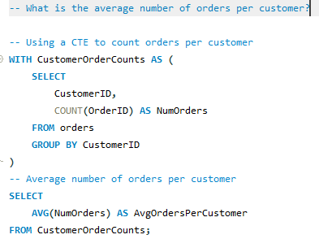

What is the average number of orders per customer?
On average, each customer places 8.54 orders, showing a good level of repeat purchasing behavior.
25

Slide 22
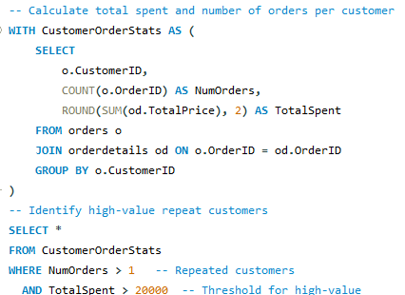
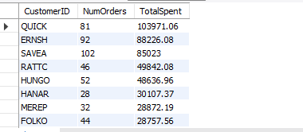
Are there high-value repeat customers?
The analysis reveals several high-value repeat customers who frequently place orders and contribute significantly to total revenue.
Top spenders: QUICK, ERNSH, and SAVEA are the most valuable customers, each spending above ₹85,000, with over 80–100 orders.
Consistent buyers: Customers like RATTC, HUNGO, and HANAR also show consistent repeat behavior with total spending between ₹30,000–₹50,000.
25

Slide 23
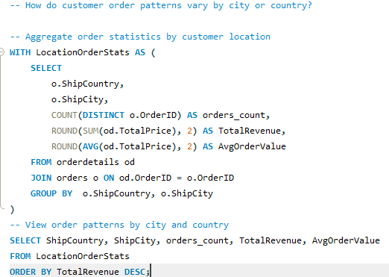
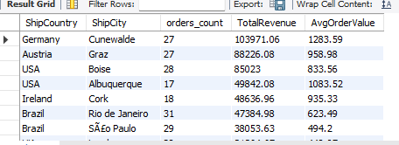
How do customer order patterns vary by city or country?
Germany (Cunewalde) leads in revenue ($103,971.06), followed by Austria (Graz) and the USA (Boise). European and North American cities show higher-value orders, while Brazil and Mexico have more frequent but lower-value purchases.
25

Slide 24
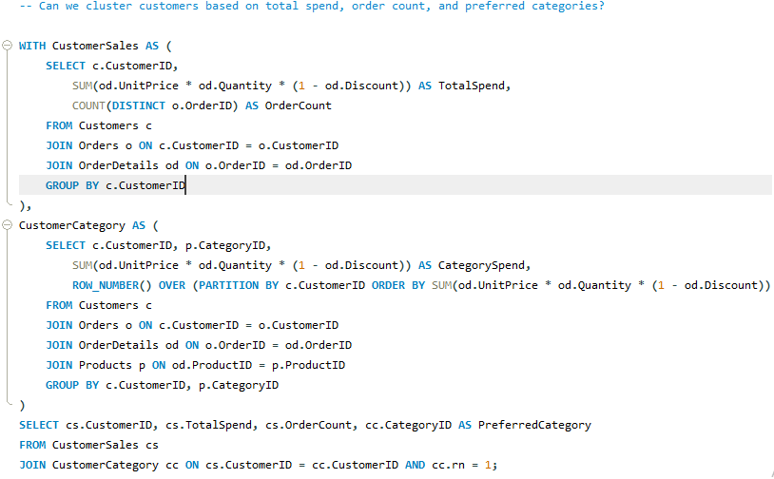
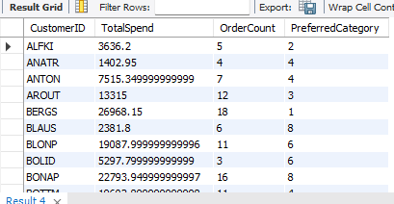
Can we cluster customers based on total spend, order count, and preferred categories?
Customers can be grouped into three main clusters 1. High spenders (e.g., QUICK, ERNSH, SAVEA) with large order counts and strong preference for categories 1 and 4. 2. Moderate spenders (e.g., FOLKO, HANAR, KOENE) with consistent orders across varied categories. 3. Low spenders (e.g., FRANS, LAZYK, CENTC) with few orders and diverse category interests. Category 1 and 4 products appear most preferred among top-spending customers.
25

Slide 25
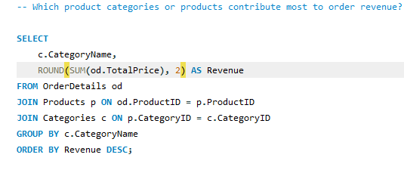
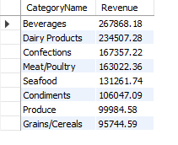
Which product categories or products contribute most to order revenue?
Beverages generate the highest revenue ($267,868.18), followed by Dairy Products and Confections, indicating strong demand for consumable goods. In contrast, Grains/Cereals and Produce contribute the least, suggesting either lower prices or smaller order volumes in these categories.
25

Slide 26
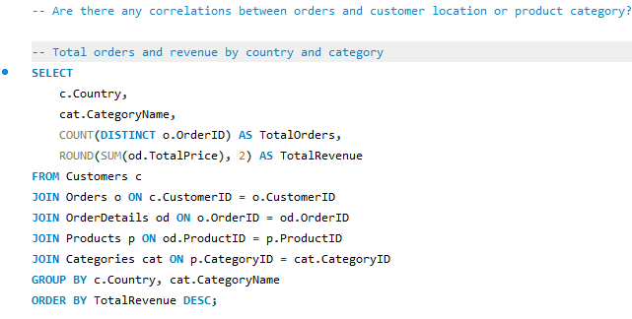
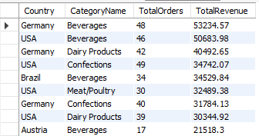
Are there any correlations between orders and customer location or product category?
Germany and USA generate the highest revenue, showing strong market demand.
Beverages, Dairy, and Confections are top-selling categories.
Country preferences vary: Germany favors Beverages/Dairy, USA favors Beverages/Confections.
Some high-revenue categories have fewer orders, indicating higher average order value.
Smaller markets show low sales, presenting opportunities for targeted campaigns.
25

Slide 27
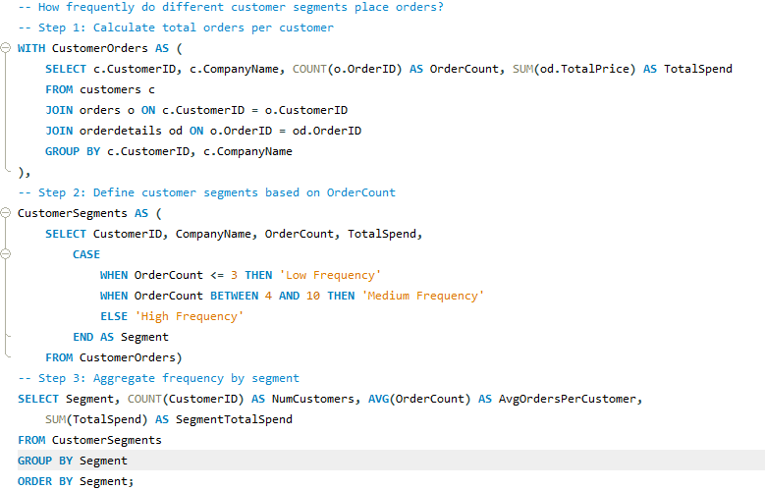

How frequently do different customer segments place orders?
High-frequency customers, though only 63 in number, place about 28 orders each and contribute the majority of revenue at around 1.1M, making them the most valuable segment. Medium-frequency customers, 24 in total, place roughly 8 orders each and contribute moderately with 51.7K in revenue. Low-frequency customers are very few, placing just 2 orders each and adding minimally to revenue at 458. Overall, a small group of loyal, high-frequency customers drives most of the business revenue.
25

Slide 28
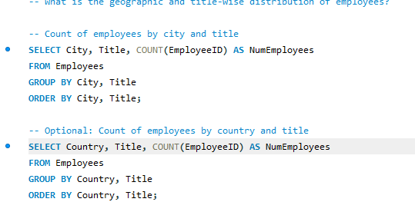
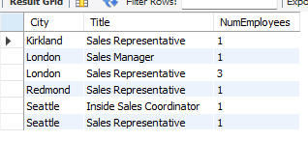

What is the geographic and title-wise distribution of employees?
The employee distribution shows that in the USA, most employees are Sales Representatives (3), with one Inside Sales Coordinator, spread across cities like Kirkland, Redmond, and Seattle. In the UK, all employees are in London, with three Sales Representatives and one Sales Manager.
25

Slide 29
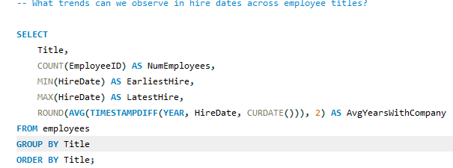

What trends can we observe in hire dates across employee titles?
The hire date trends indicate that the workforce has been largely stable over time. Sales Representatives were hired between 1992 and 1994, with an average tenure of about 31.7 years, showing long-term retention in this role. Both the Sales Manager and Inside Sales Coordinator were hired in 1993–1994, also with over 31 years at the company. Overall, all employee titles reflect very long tenures, suggesting low turnover and a highly experienced team.
25

Slide 30
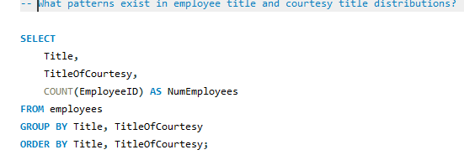
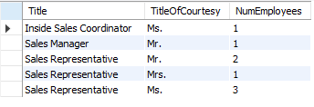
What patterns exist in employee title and courtesy title distributions?
The distribution of employee titles and courtesy titles shows that Sales Representatives are the most diverse group in terms of courtesy titles, with 2 “Mr.”, 1 “Mrs.”, and 3 “Ms.”. The Sales Manager is “Mr.”, and the Inside Sales Coordinator is “Ms.”. Overall, while roles are concentrated in sales, courtesy titles indicate a mix of genders across the positions, especially among Sales Representatives.
25

Slide 31
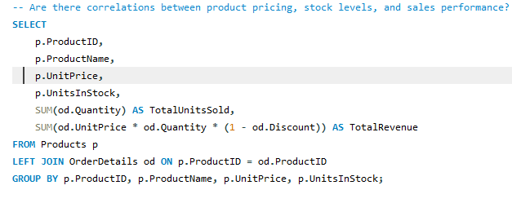
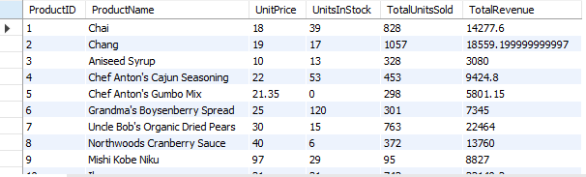
Are there correlations between product pricing, stock levels, and sales performance?
Moderate-priced, well-stocked items tend to sell higher units.
Premium products generate high revenue with fewer units sold.
Stock levels matter, but demand and pricing strategy play a bigger role in total revenue.
25

Slide 32
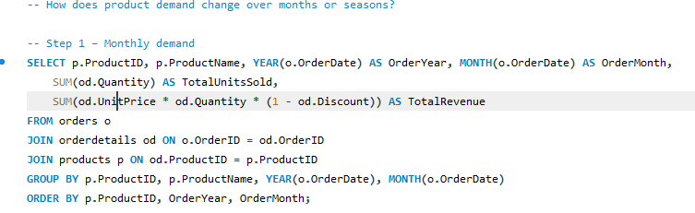
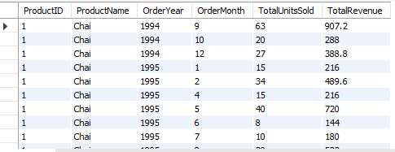
How does product demand change over months or seasons?
Monthly insights show clear seasonal trends: beverages peak in spring, pastries like Pavlova and scones sell more in specific months, while some products dip in winter or summer. Identifying high- and low-demand months helps plan promotions, inventory, and marketing to maximize revenue and stabilize sales throughout the year.
Winter demand: Cranberry, Christmas/holiday products, chocolate-based items.
Spring demand: Fresh produce or specialty products (dried fruits, seasonal spreads).
Summer demand: Some light beverages or spreads.
Fall demand: Spices, teas, and products tied to autumn cooking.
25

Slide 33
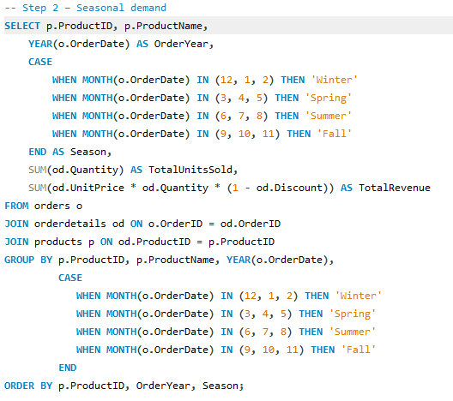
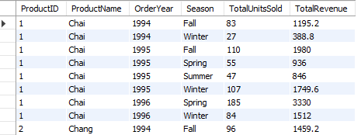
How does product demand change over months or seasons?
Winter demand: Cranberry, Christmas/holiday products, chocolate-based items.
Spring demand: Fresh produce or specialty products (dried fruits, seasonal spreads).
Summer demand: Some light beverages or spreads.
Fall demand: Spices, teas, and products tied to autumn cooking.
25

Slide 34
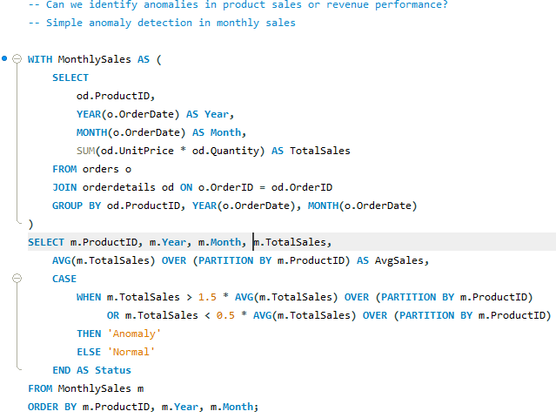
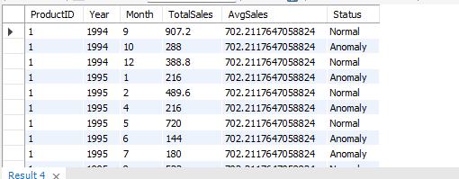
Can we identify anomalies in product sales or revenue performance?
Analysis of monthly sales reveals notable anomalies across products. Certain months show unexpected spikes, likely due to promotions or bulk purchases, while sharp declines indicate stockouts, seasonal slowdowns, or reduced demand. Identifying these trends enables better inventory planning, targeted marketing, and optimized pricing strategies, helping the business anticipate fluctuations, improve revenue, and make data-driven operational decisions efficiently.
25

Slide 35
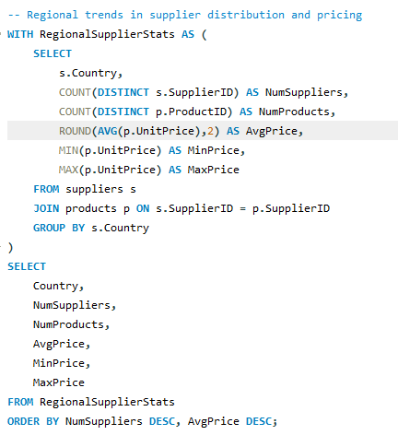
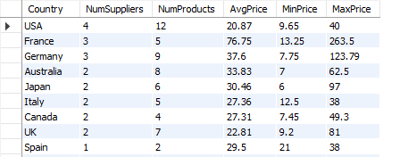
Are there any regional trends in supplier distribution and pricing?
Analysis of supplier distribution and pricing shows clear regional trends. The USA leads in supplier count and product variety, while European countries like France and Germany have fewer suppliers but higher average prices. Asia-Pacific regions (Japan, Australia, Singapore) show moderate pricing with varied product availability. Countries with single suppliers generally have limited products and lower price ranges, indicating market concentration.
25

Slide 36
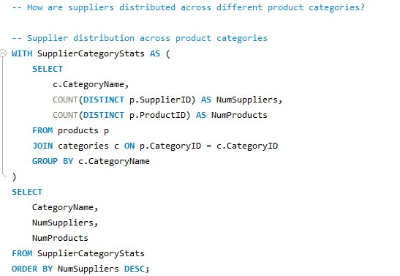
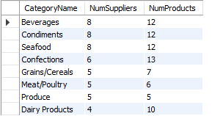
How are suppliers distributed across different product categories?
Analysis of supplier distribution across product categories reveals that Beverages, Condiments, and Seafood have the highest supplier participation, each with 8 suppliers and 12 products. Confections follow with 6 suppliers and 13 products. Categories like Grains/Cereals, Meat/Poultry, Produce, and Dairy Products have fewer suppliers, indicating more concentrated supply in these areas.
25

Slide 37
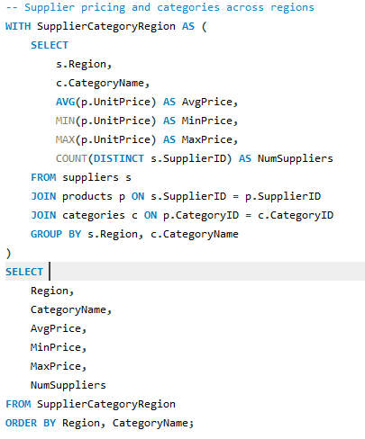
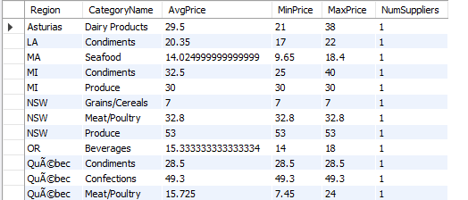
How do supplier pricing and categories relate across different regions?
Regions like Unknown have the most diverse suppliers and price ranges, e.g., Beverages range from 4.5 to 263.5.
Victoria, MI, NSW, and Asturias show more uniform pricing per category with single suppliers.
Some categories, such as Meat/Poultry and Seafood, exhibit higher average prices in specific regions, indicating regional pricing strategies.
Overall, supplier pricing correlates with both region and product category, reflecting localized market differences.
25

